Slide 1
MACHINE LEARNING
SPECIAL ASSIGNMENT
19BCE271 TAHA FIROZ
19BCE299 MEET VORA

Slide 2
ADULT DATA SET
This data was extracted from the census bureau database found at http://www.census.gov/ftp/pub/DES/www/welcome.html.
The donors of the dataset are Ronny Kohavi and Barry Becker.
Prediction task is to determine whether a person makes over 50K a year.
The whole dataset including the test set consists of 48842 instances.
The accuracy obtained by the authors varied in between 84.5 - 86.5.
In this assignment we have done exploratory data analysis and trained our model on different classifiers and compared their accuracies.

Slide 3
DATA ANALYSIS

Slide 4
The data uploaded by the authors is in the raw form which is converted into dataframe for better interpretability.
Training set contains 32561 data points with 15 features.
Testing set contains 16281 data points with 15 features.
CODE :
def to_csv(filename):
df = pd.read_csv(filename,header=None)
df.columns = ['age','workclass','fnlwgt','education','education_num','marital_satus',
'occupation','relationship','race','sex','capital_gain','capital_loss',
'hours_per_week','native_country','class']
df = df.replace( '[\?,)]',np.nan, regex=True )
return df

Slide 5
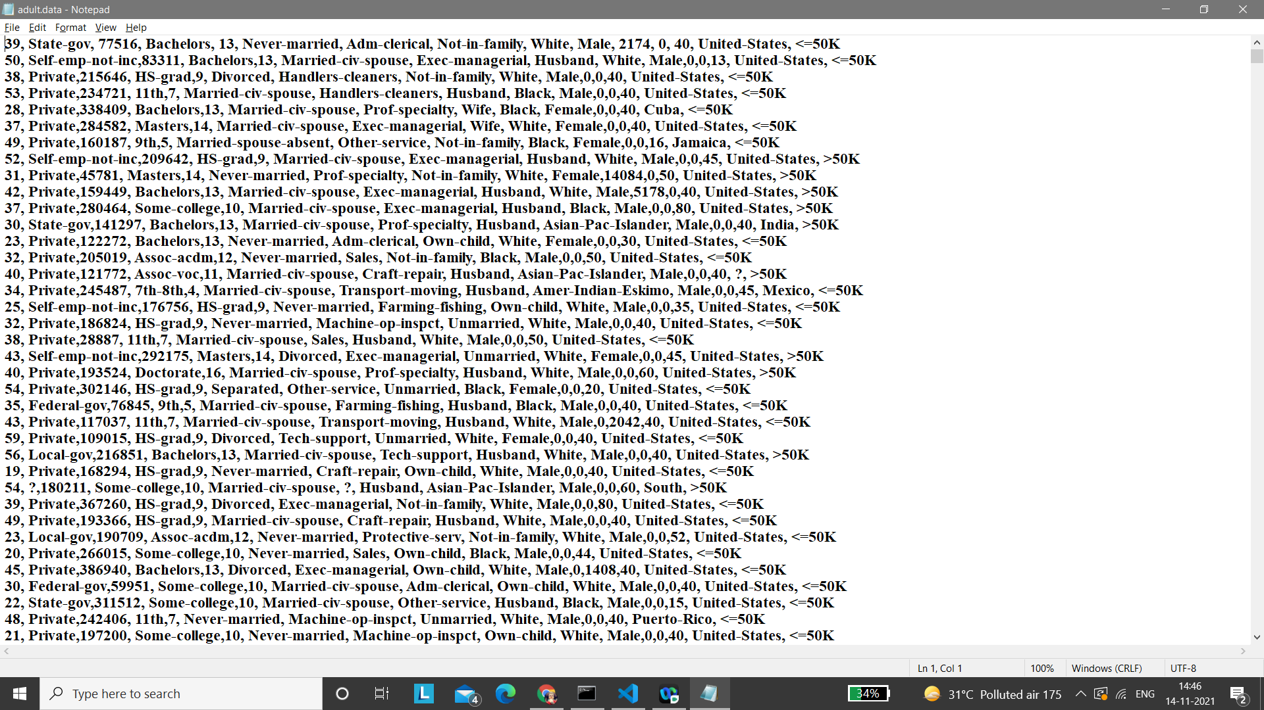
DATA IN RAW FORM
TRAINING DATA

Slide 6
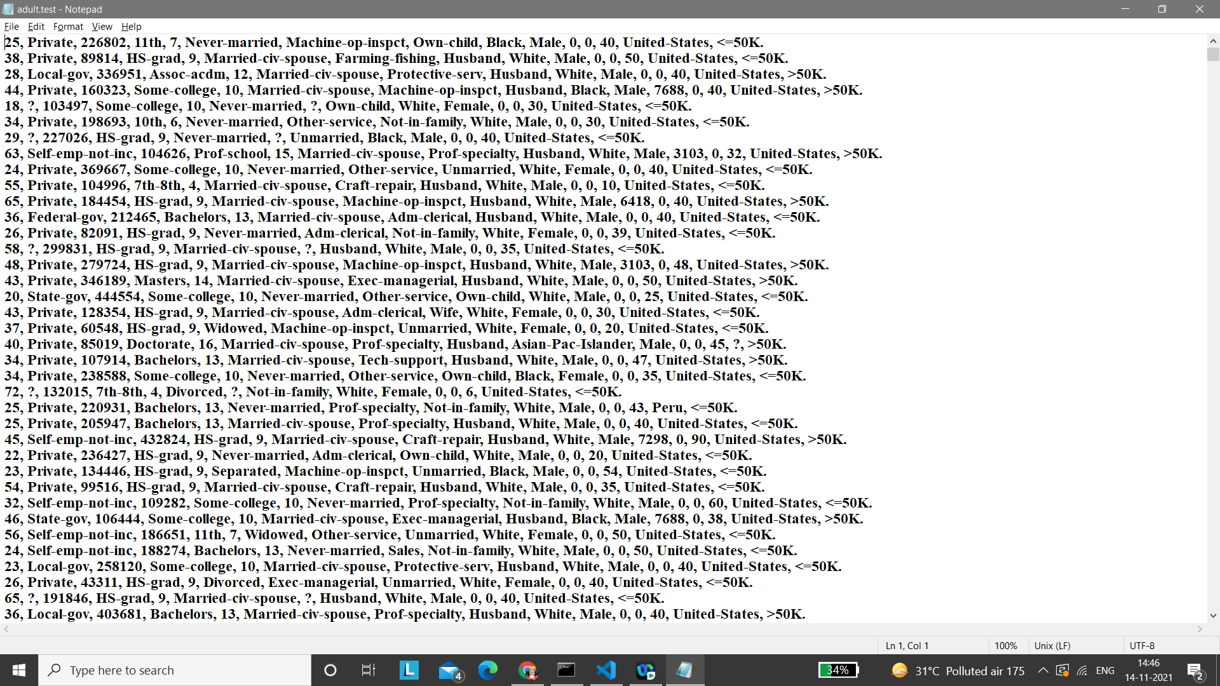
DATA IN RAW FORM
TESTING DATA

Slide 7
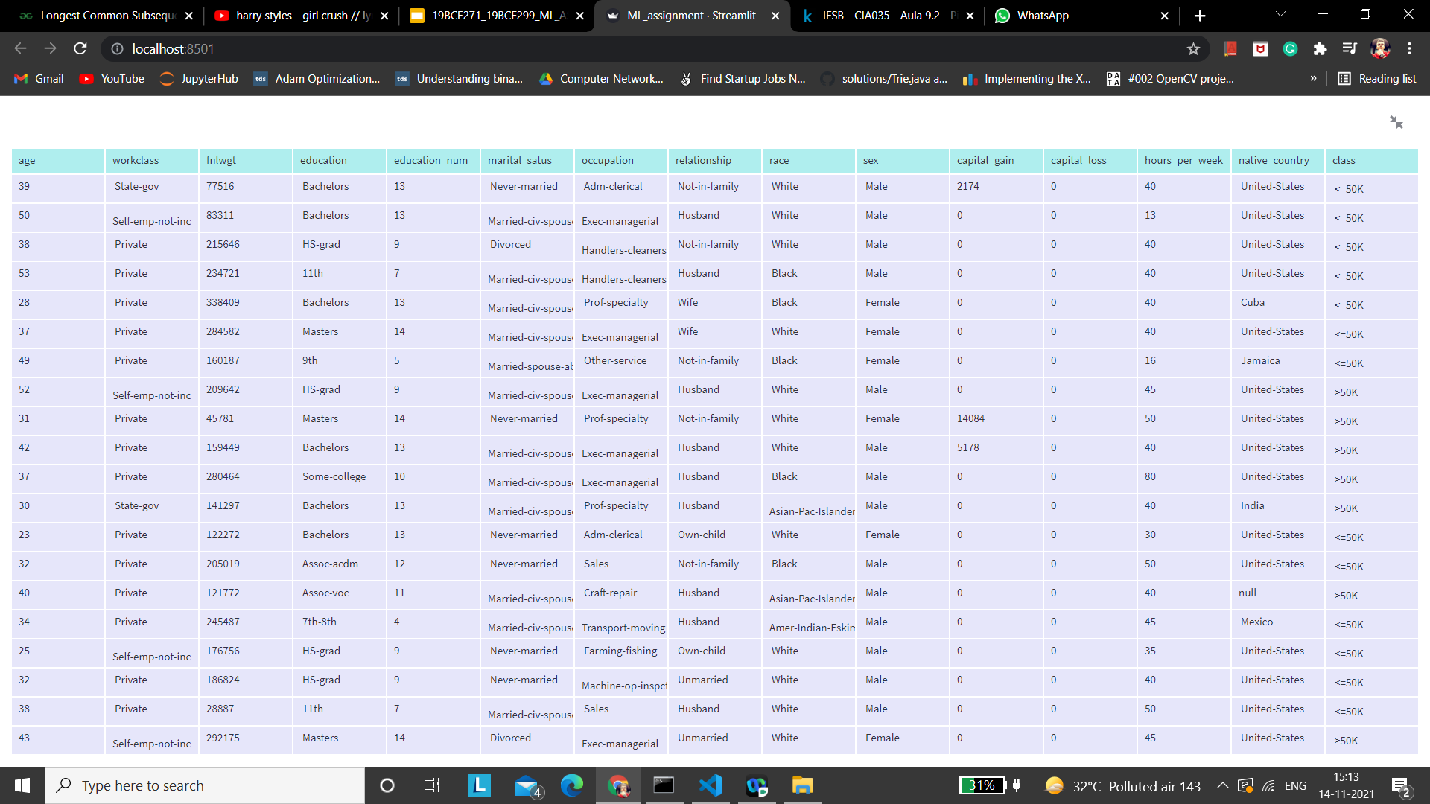
TO DATAFRAME
TRAINING SET

Slide 8

TO DATAFRAME
TESTING SET

Slide 9
DATA SCRUBBING

Slide 10
DATA CLEANSING
The training and testing set NAN and duplicate values which are not necessary for our ML classifier.
There are 24 duplicates in the training set and 5 duplicates in the testing set.
There are 2413 NaN values in the training and 1229 NaN in the testing set.
CODE:
df_train_nan = df_train.dropna() #to remove nan values
df_train_dup = df_train.drop_duplicates() #to remove duplicate values

Slide 11

REMOVING NAN
TRAINING SET

Slide 12
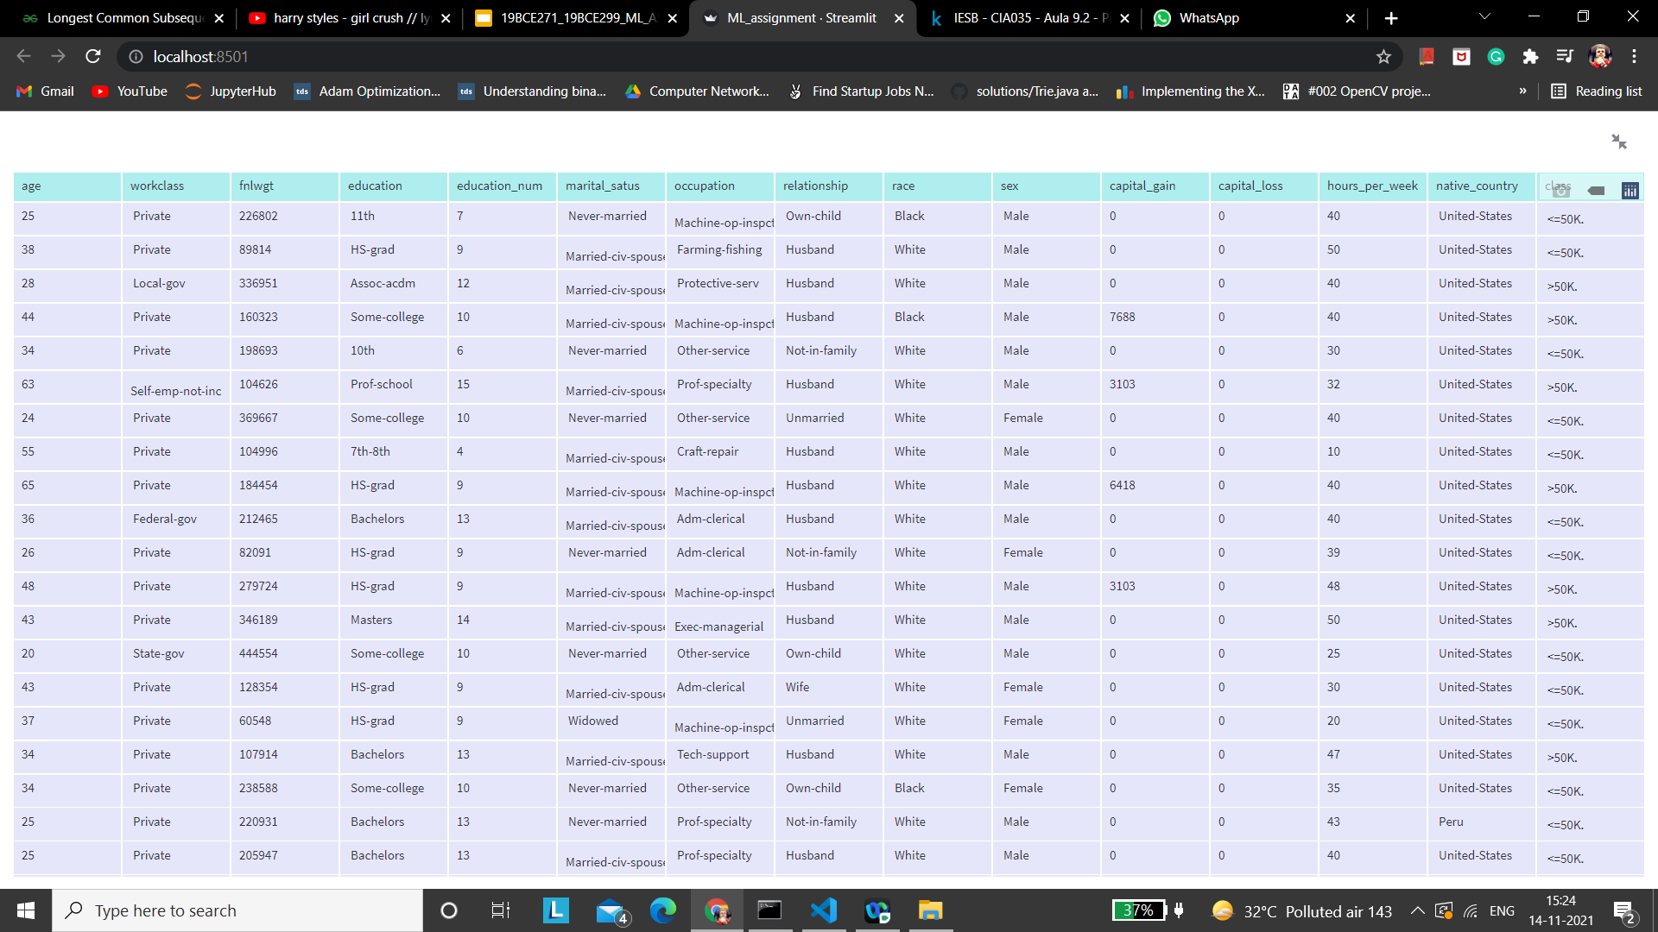
REMOVING NAN
TESTING SET

Slide 13

REMOVING DUPLICATES
TRAINING SET

Slide 14
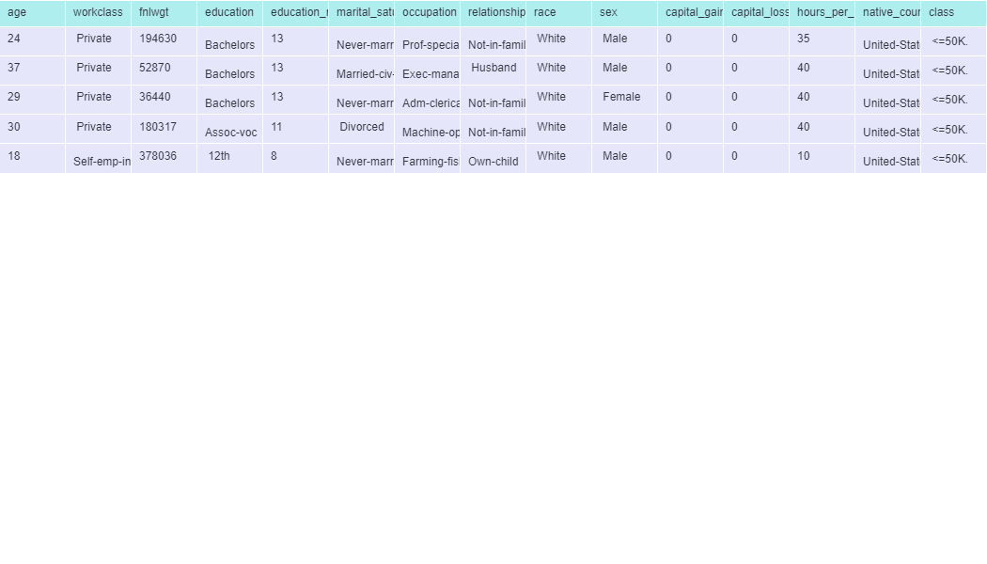
REMOVING DUPLICATES
TESTING SET

Slide 15
DATA VISUALIZATION

Slide 16
DATA INTERPRETATION USING FEATURES
Data visualization is one of the steps of the data science process, which states that after data has been collected, processed and modeled, it must be visualized for conclusions to be made.
Data visualization is also an element of the broader data presentation architecture (DPA) discipline, which aims to identify, locate, manipulate, format and deliver data in the most efficient way possible.
The following graphs shows the distribution of features and their impact on the outcome.

Slide 17
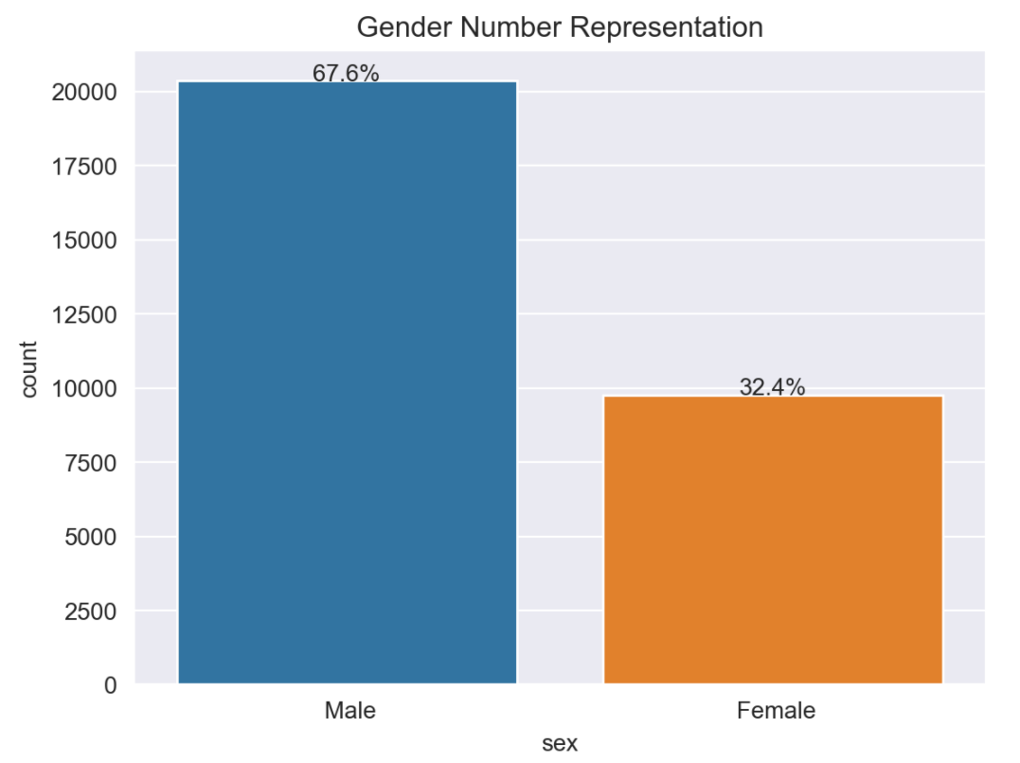

Slide 18
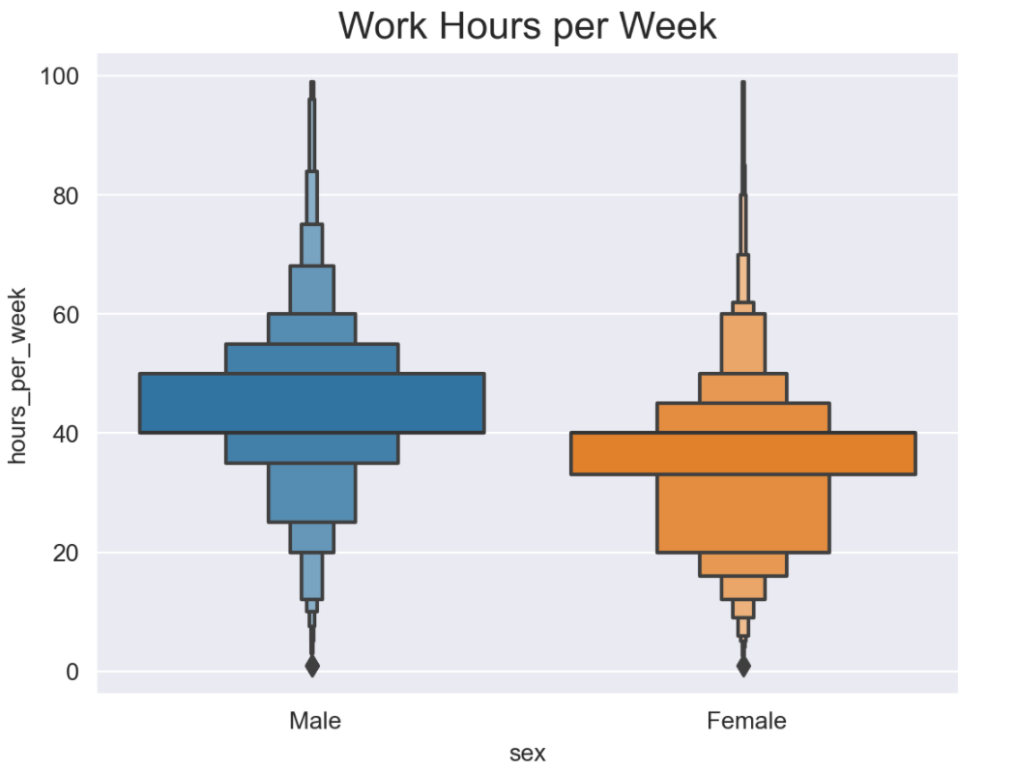

Slide 19
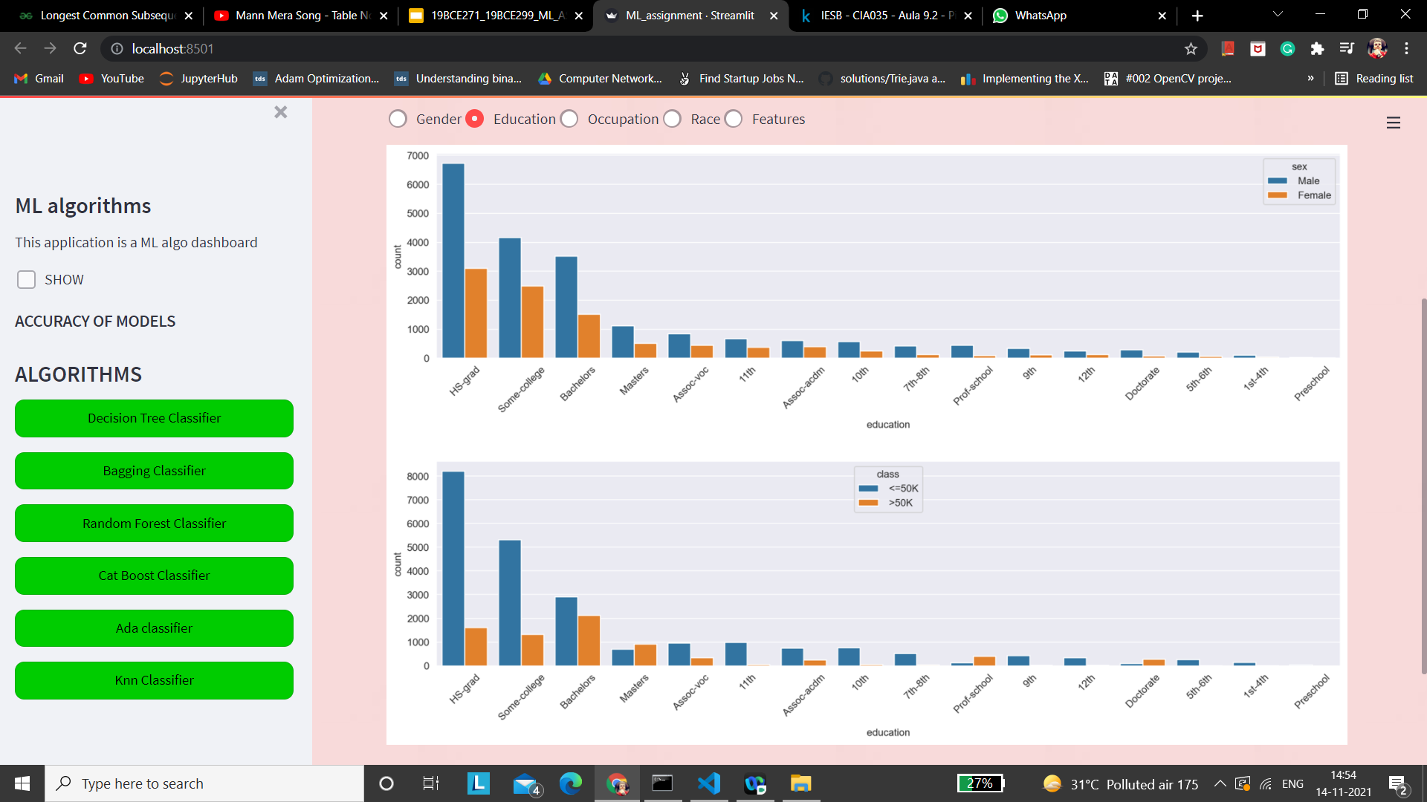

Slide 20
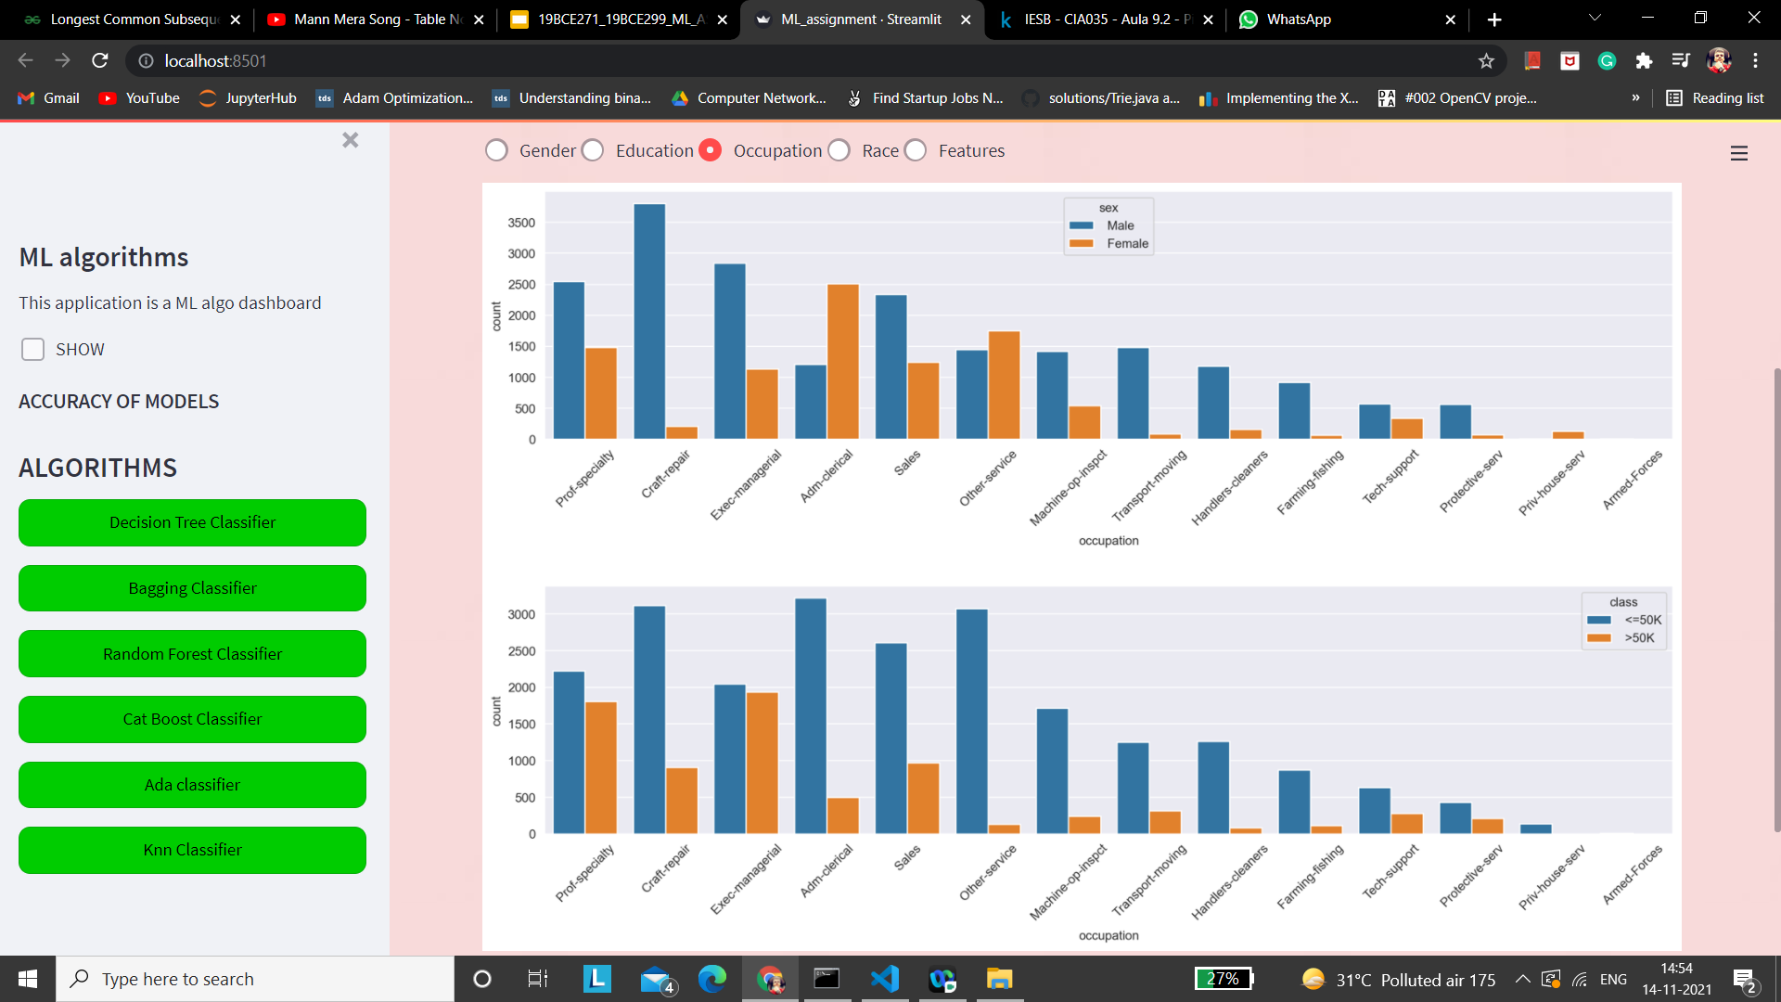

Slide 21
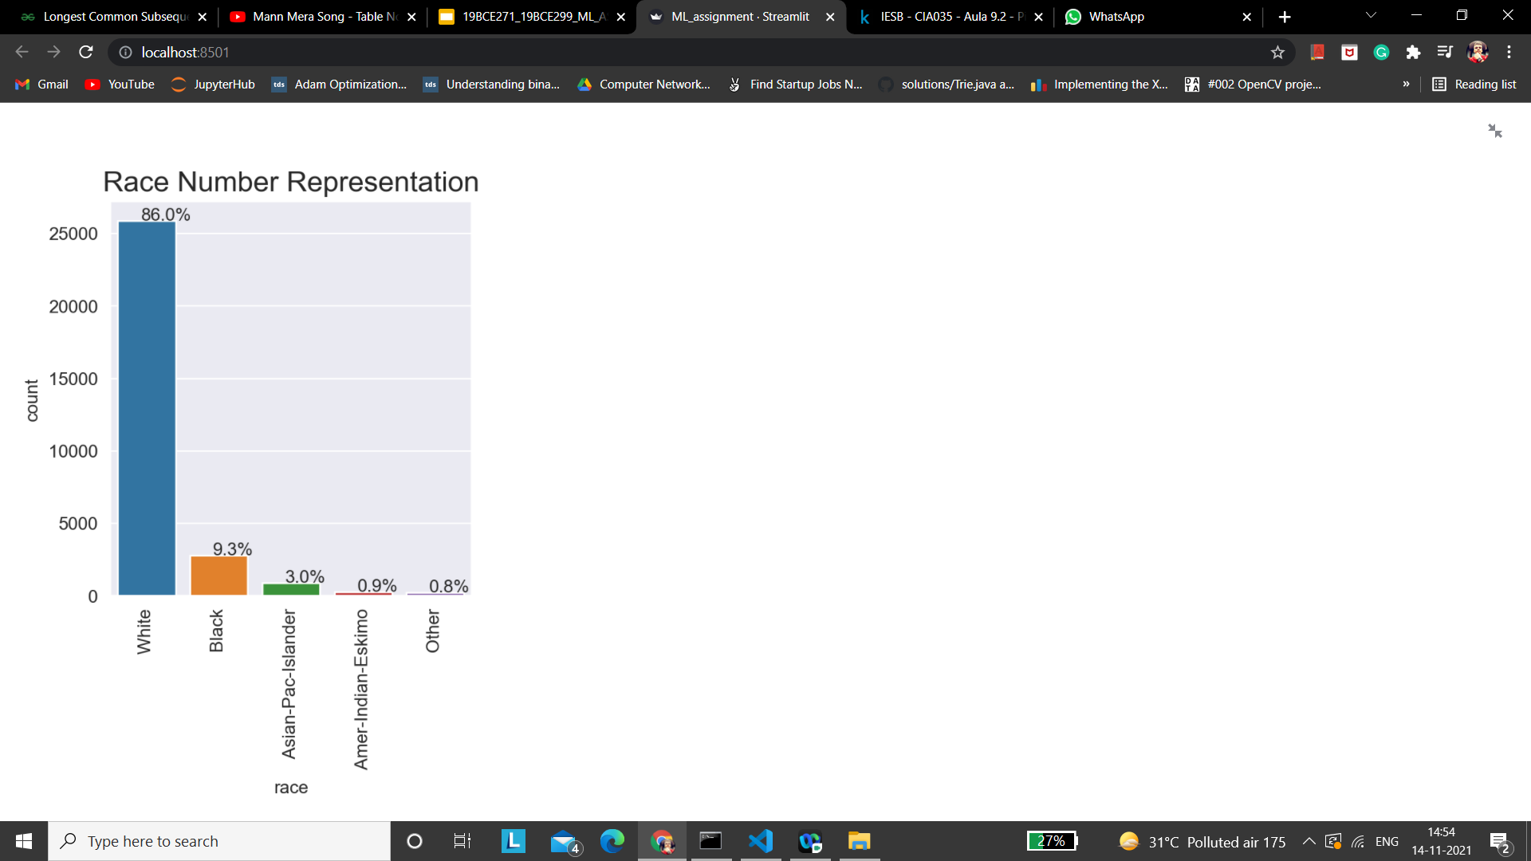

Slide 22
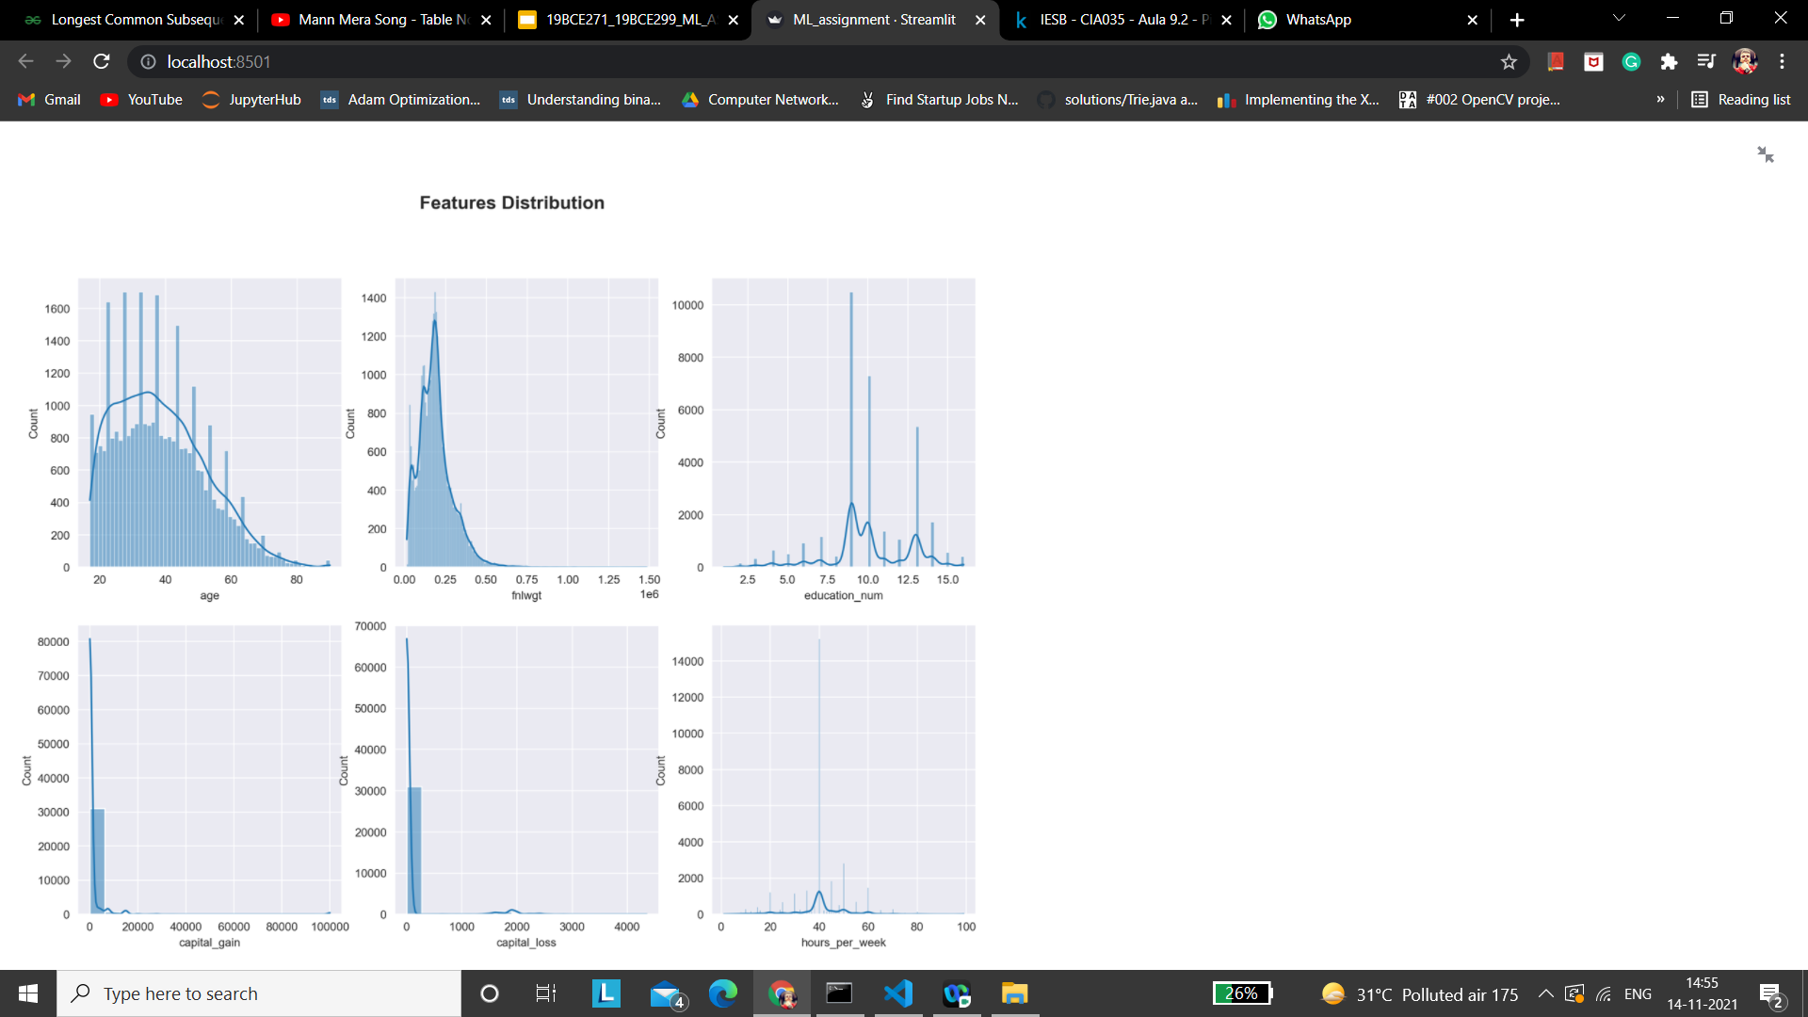

Slide 23
LABEL ENCODING
Label encoding is the process of translating labels into numeric format so that they can be read by machines.
Machine learning algorithms can then better decide how those labels should be used.
In supervised learning, it is a crucial pre-processing step for the structured dataset.

Slide 24
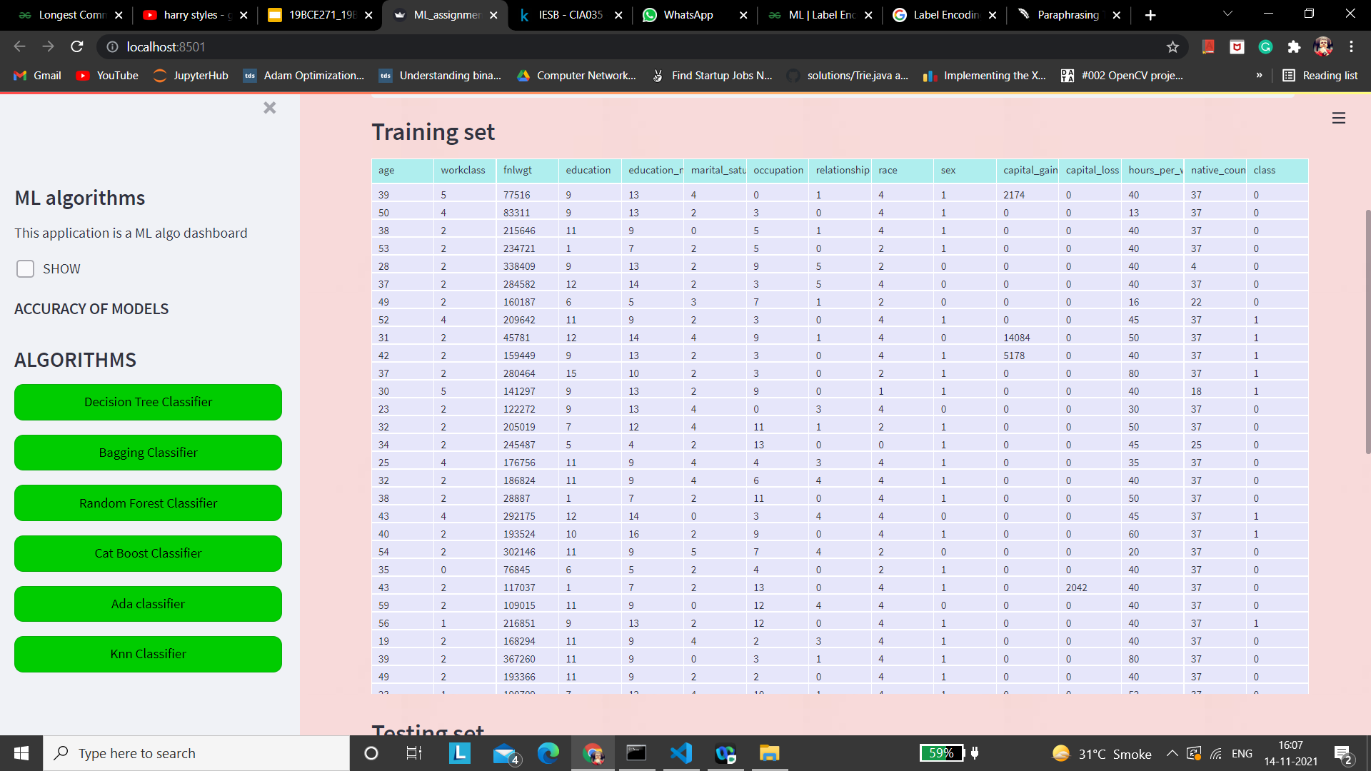

Slide 25


Slide 26
SMOTE FOR IMBALANCED DATASET
SMOTE is an oversampling technique where the synthetic samples are generated for the minority class.
This algorithm helps to overcome the overfitting problem posed by random oversampling. It focuses on the feature space to generate new instances with the help of interpolation between the positive instances that lie together.
smote = SMOTE()
X_train, y_train = smote.fit_resample(df_train_encode.drop(['class','fnlwgt'],axis=1),df_train_encode['class'])
X_test, y_test = smote.fit_resample(df_test_encode.drop(['class','fnlwgt'],axis=1),df_test_encode['class'])

Slide 27
CLASSIFICATION ALGORITHMS

Slide 28
DECISION TREE CLASSIFIER
Definition:
It’s a binary tree that recursively splits the dataset until we are left with pure leaf nodes, i.e. the data with only one type of class.
Advantages:
Simple.
Not affected by missing values.
Disadvantages:
Unstable. A small change in the data can result in a drastic change in the structure of the tree.

Slide 29
ACCURACY
Train Accuracy : 0.8563
Test Accuracy : 0.8375

Slide 30
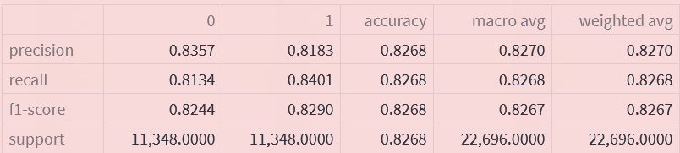
CLASSIFICATION REPORT

Slide 31
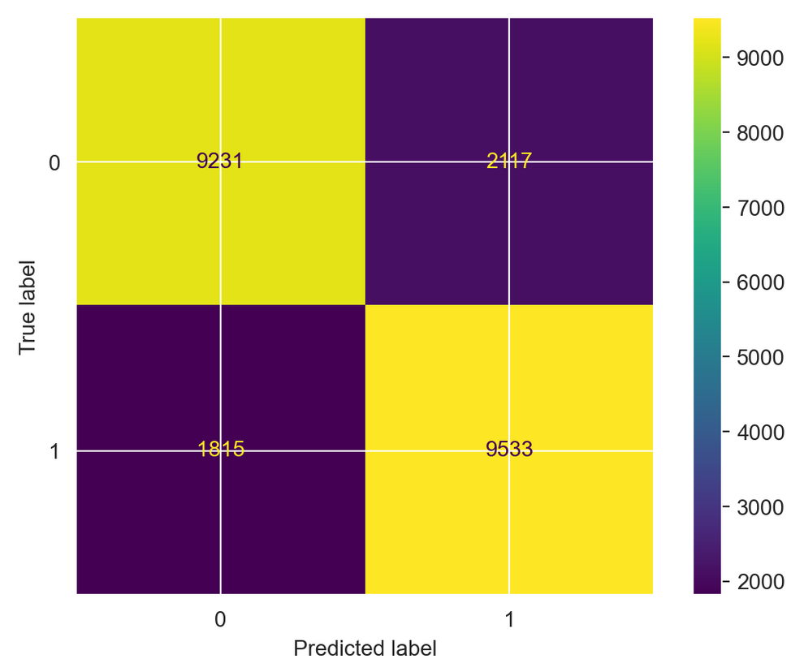
CONFUSION MATRIX

Slide 32
BAGGING CLASSIFIER
Definition:
This classifier randomly generates training sets from the original training set. The model is trained on all those subsets and all the predictions are used to form the final prediction.
Advantages:
Removes overfitting.
Disadvantages:
Increases bias.

Slide 33
ACCURACY
Train Accuracy : 0.8553
Test Accuracy : 0.8303

Slide 34
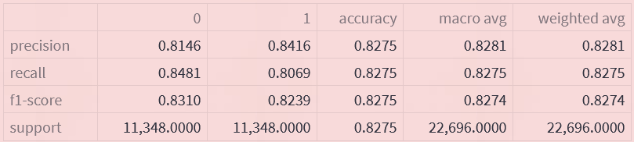
CLASSIFICATION REPORT

Slide 35
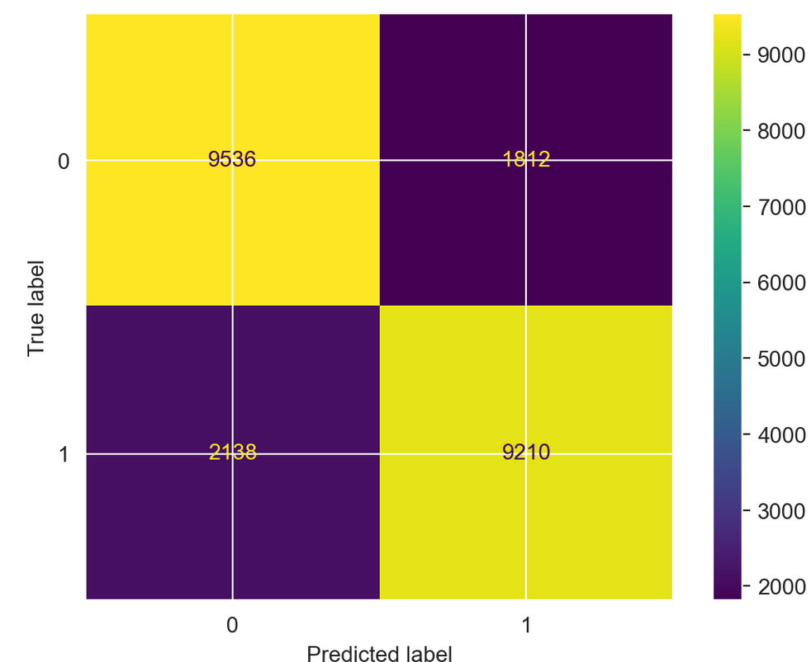
CONFUSION MATRIX

Slide 36
RANDOM FOREST CLASSIFIER
Definition:
This classifier will make many decision trees by using different training data. Bagging method and feature randomness is used to train each tree to make a set of unrelated trees. The popular answer is chosen.
Advantages:
This method’s prediction reduces overfitting and the prediction is better than any of the individual trees.
Disadvantages:
They do not perform well on high dimensional sparse data.

Slide 37
ACCURACY
Train Accuracy : 0.8973
Test Accuracy : 0.8581

Slide 38
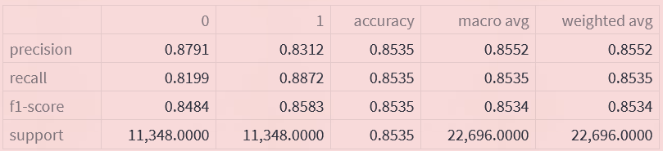
CLASSIFICATION REPORT

Slide 39
CONFUSION MATRIX

Slide 40
CAT BOOST CLASSIFIER
Definition:
This is a gradient boosting technique for decision trees. Takes care of the tuning of multiple hyperparameters.
Advantages:
No pre-processing of data is required..
Reduces overfitting.
Disadvantages:
Time taking.

Slide 41
ACCURACY
Train Accuracy : 0.8817
Test Accuracy : 0.8717

Slide 42
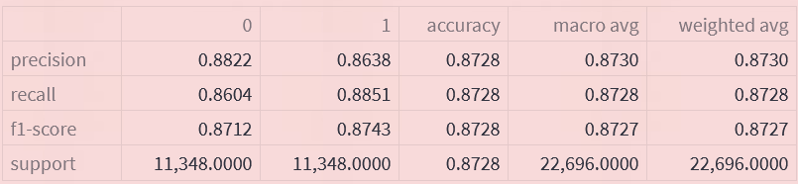
CLASSIFICATION REPORT

Slide 43
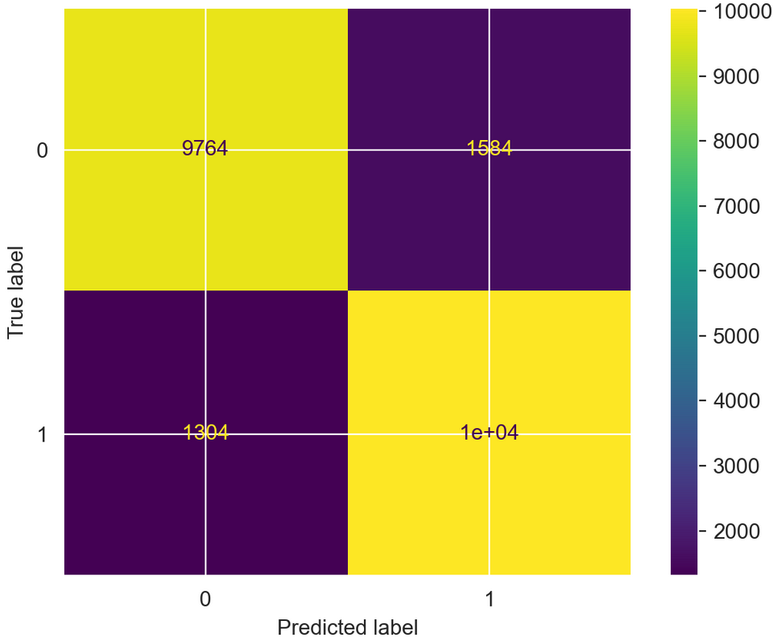
CONFUSION MATRIX

Slide 44
KNN CLASSIFIER
Definition:
KNN works by finding the distances between a query and all the examples in the data, selecting the specified number examples (K) closest to the query, then votes for the most frequent label (in the case of classification) or averages the labels (in the case of regression).
Advantages:
Easy to implement.
Easy addition of new data.
Disadvantages:
Sensitive to noisy data,missing and outliers.
Doesn’t work well with high dimensions and large datasets.

Slide 45
ACCURACY
Train Accuracy : 0.8277
Test Accuracy : 0.8011

Slide 46
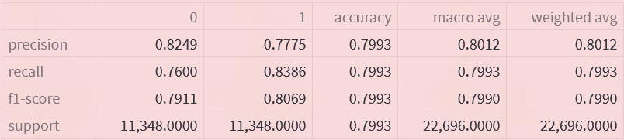
CLASSIFICATION REPORT

Slide 47
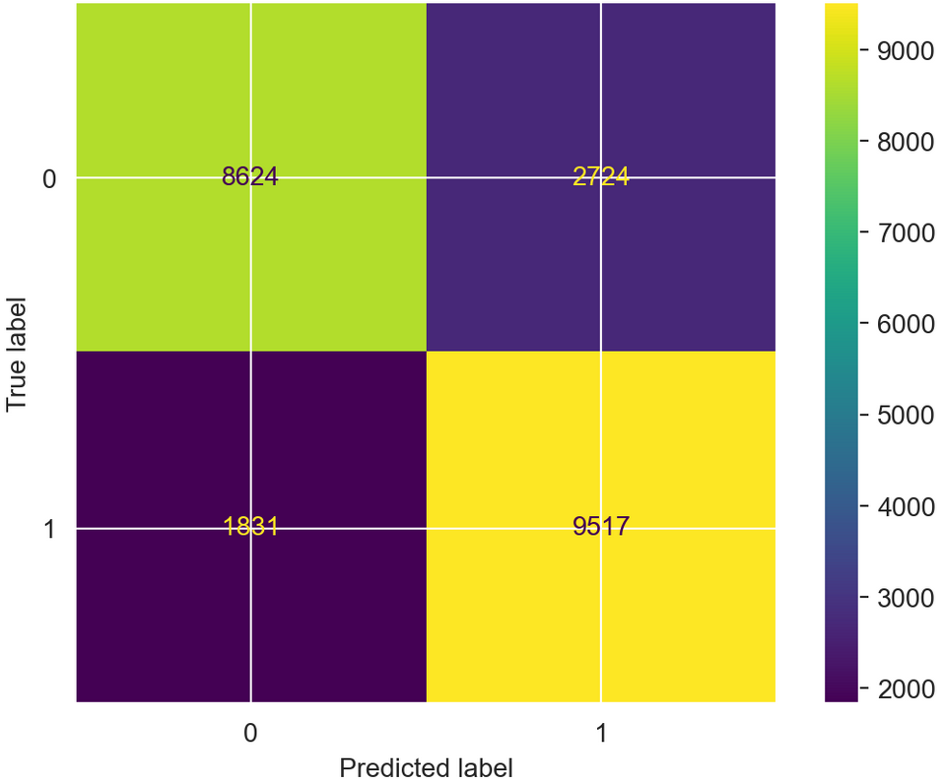
CONFUSION MATRIX

Slide 48
ADABOOST CLASSIFIER
Definition:
It is a meta-estimator that begins by fitting a classifier on the original dataset and then fits additional copies of the classifier on the same dataset but where the weights of incorrectly classified instances are adjusted such that subsequent classifiers focus more on difficult cases.
Advantages:
AdaBoost classifier builds a strong classifier by combining multiple poorly performing classifiers so that you will get high accuracy strong classifier.
Disadvantages:
AdaBoost is also extremely sensitive to Noisy data and outliers

Slide 49
ACCURACY
Train Accuracy : 0.8381
Test Accuracy : 0.8417

Slide 50
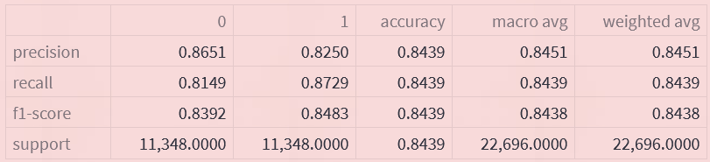
CLASSIFICATION REPORT

Slide 51
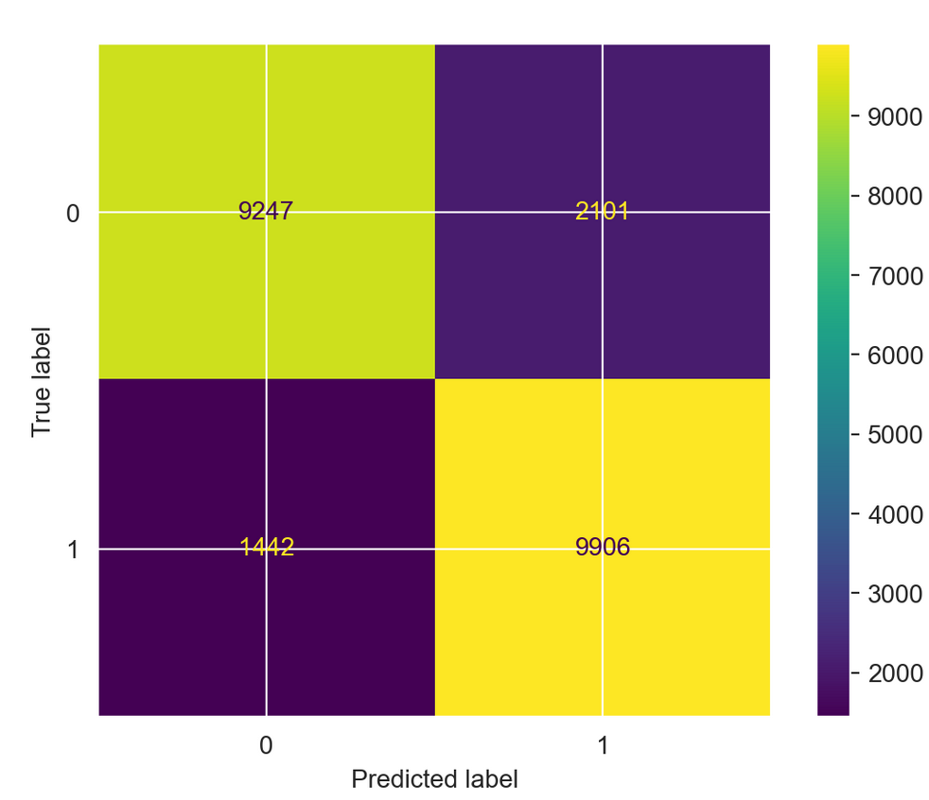
CONFUSION MATRIX

Slide 52
RESULTS
AND
CONCLUSION

Slide 53
RESULTS
After rigorous data analysis and model testing, we observed that all the classifiers except Adaboost and KNN classifier performed well on training set with an accuracy between 0.85 to 0.89.
All the classifiers except KNN were able to generalize the test set with accuracy between 0.83 to 0.87.
Overall, ensemble classifiers fit and generalized the model with accuracy above 0.85.
The accuracy obtained by author’s approach was 86.9 above we which we got an accuracy of 87.7 for Cat Boost Classifier.

Slide 54
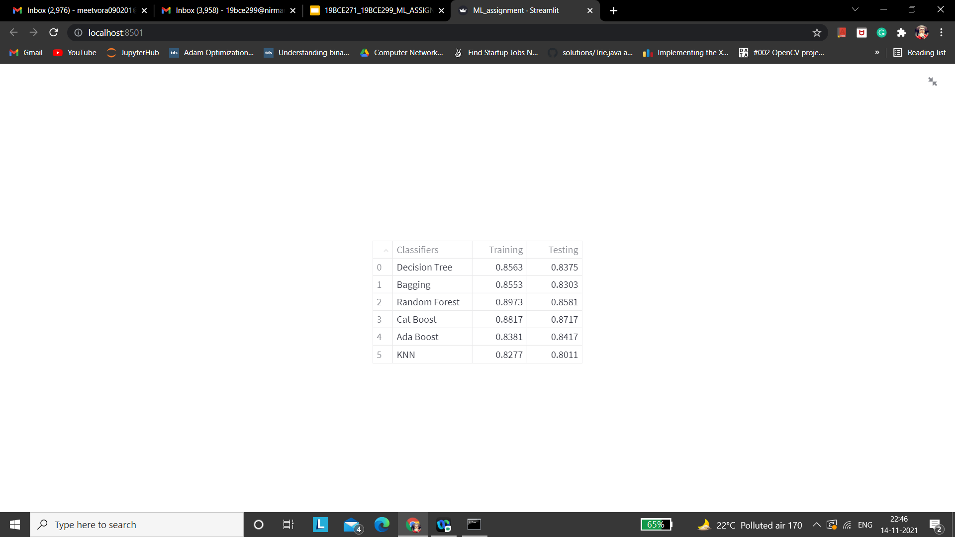
ACCURACY TABLE

Slide 55
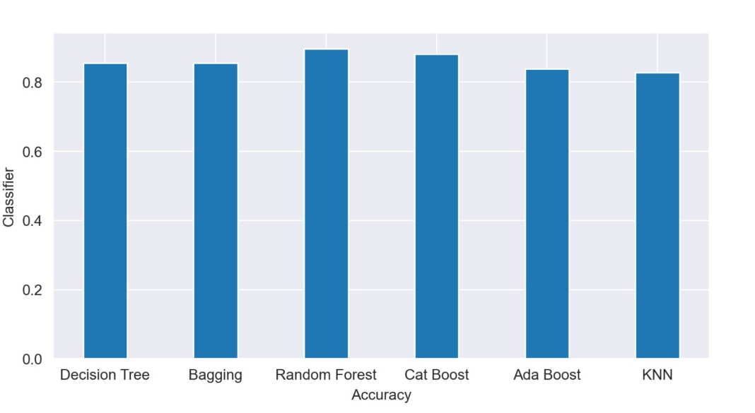
TRAINING ACCURACY

Slide 56
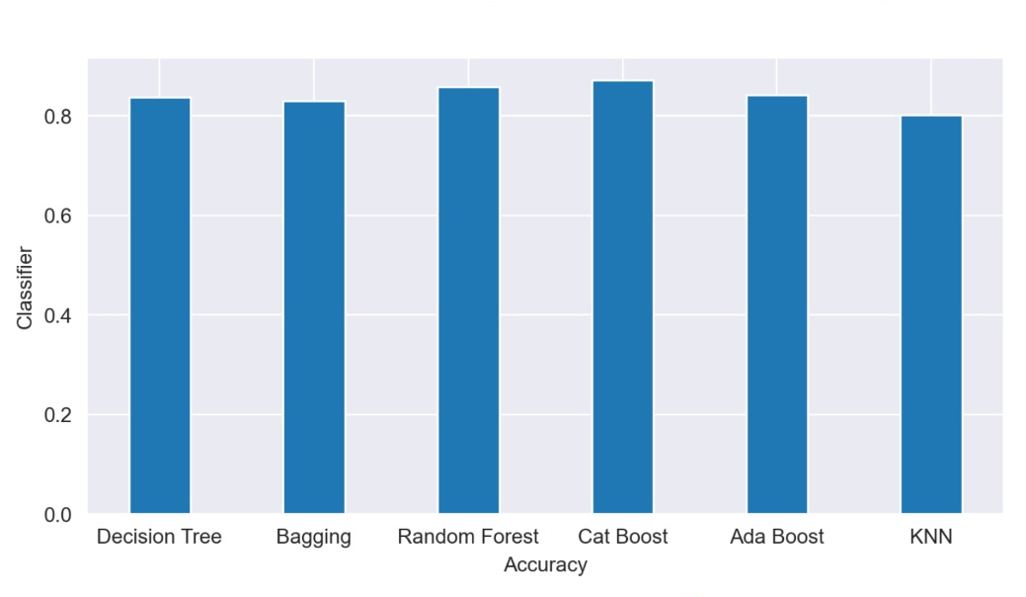
TESTING ACCURACY

Slide 57
AVERAGE TIME TAKEN BY EACH CLASSIFIER
Classifiers | Average Time Taken in seconds
Decision Tree | 0.611
Bagging Classifier | 0.975
Random Forest | 7.056
Cat Boost | 6.839
Ada Boost | 5.879
KNN | 123.457

